Slide 1
BANKING SYSTEM
Presented by
Jebastin Raj

Slide 2
OUTLINE
Purpose
Application Description
System Requirements

Slide 3
Purpose
To develop a software for solving financial application of a customer in banking environment

Slide 4
Application Description
The Bank management system is an application for maintaining a person’s account in a bank.
The system provides the access to the customer to create an account , deposit ,
withdraw the cash from an account, also to view balance of the account.

Slide 5
System Requirement
Software Requirements.
Hardware Requirements.

Slide 6
Software Requirements
Name of the component
Specification
Operating
Code Editor
Languages
Windows
Eclipse IDE
Java

Slide 7
Hardware Requirements
Name of the component
Specification
Processor
Ram
Hard Disk
System Type
Intel core i5
8GB
1TB
64-operation system

Slide 8
Module Descriptions
Create an account(maximum 5 customer)
Display account details
Balance checking details
Deposit & Withdraw Details
Exit

Slide 9
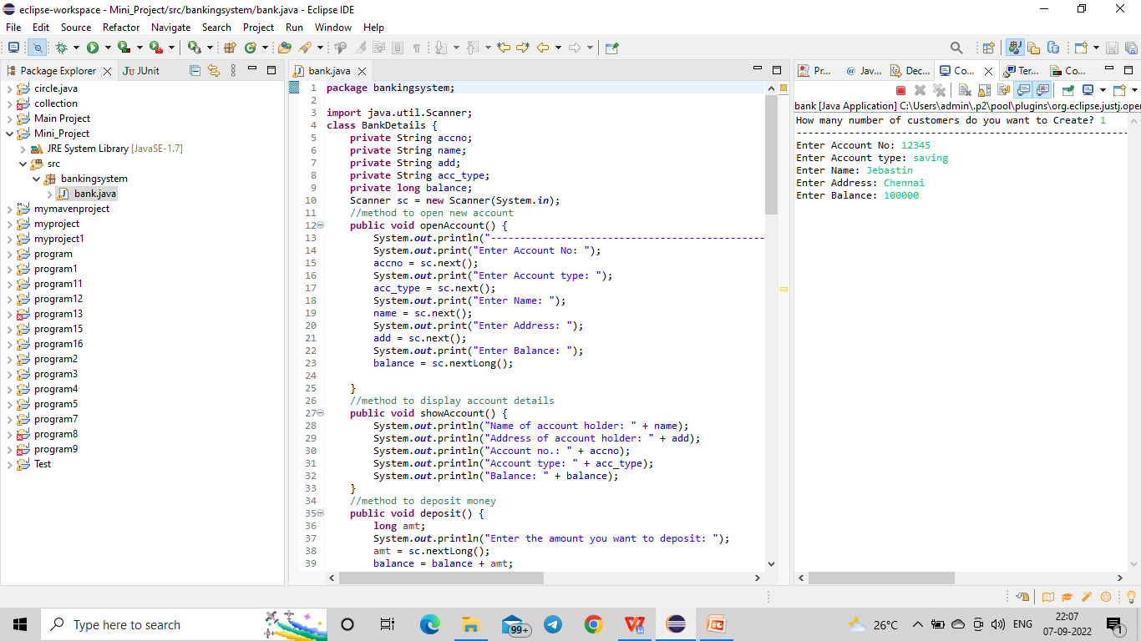
Create an account(maximum 5 customer)

Slide 10
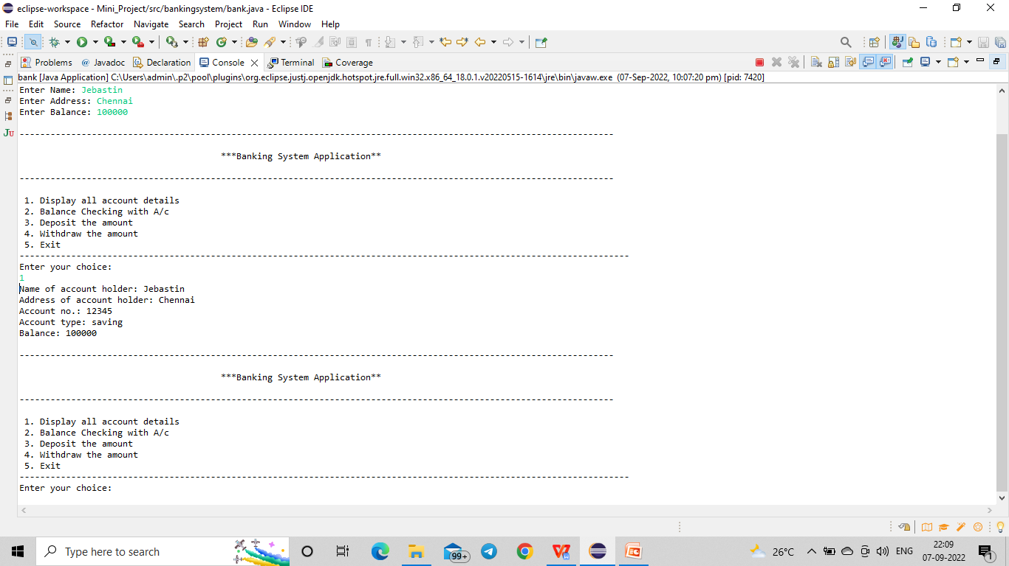
Display account details

Slide 11
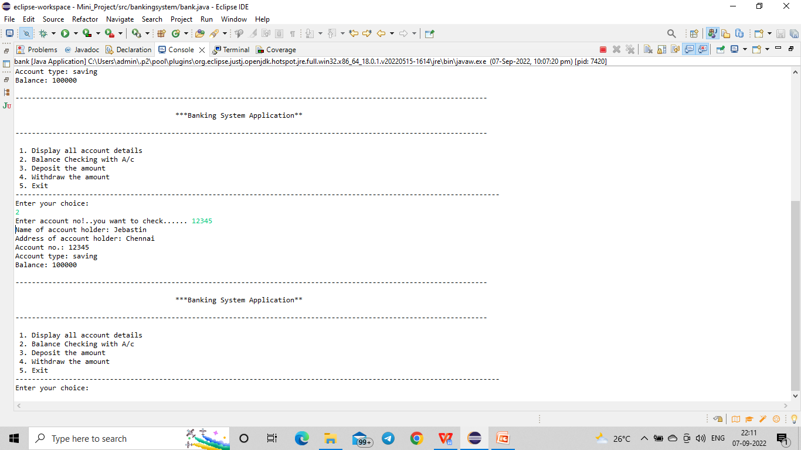
Balance checking details

Slide 12
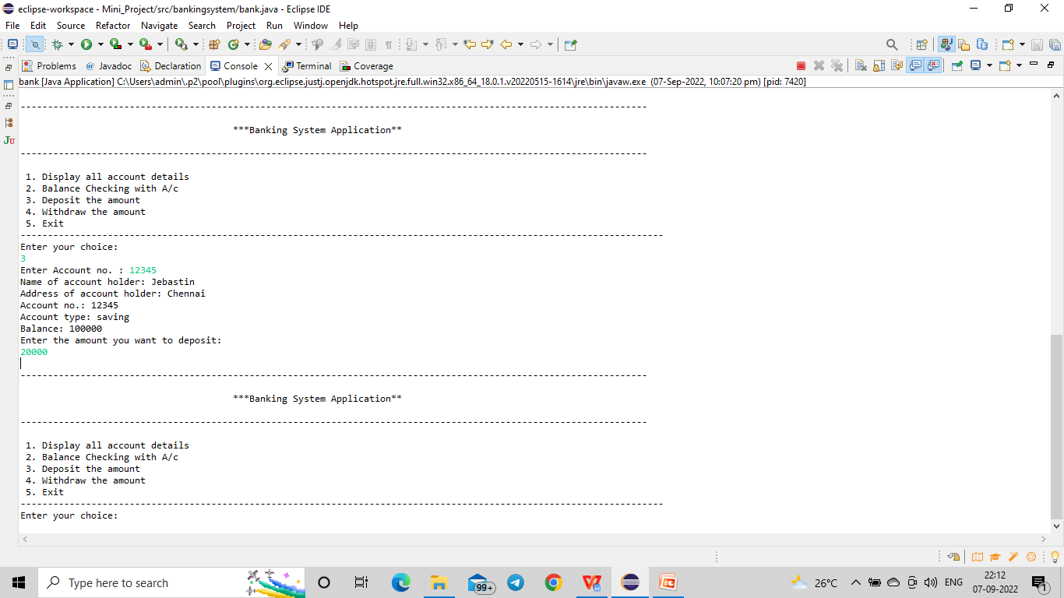
Deposit details

Slide 13
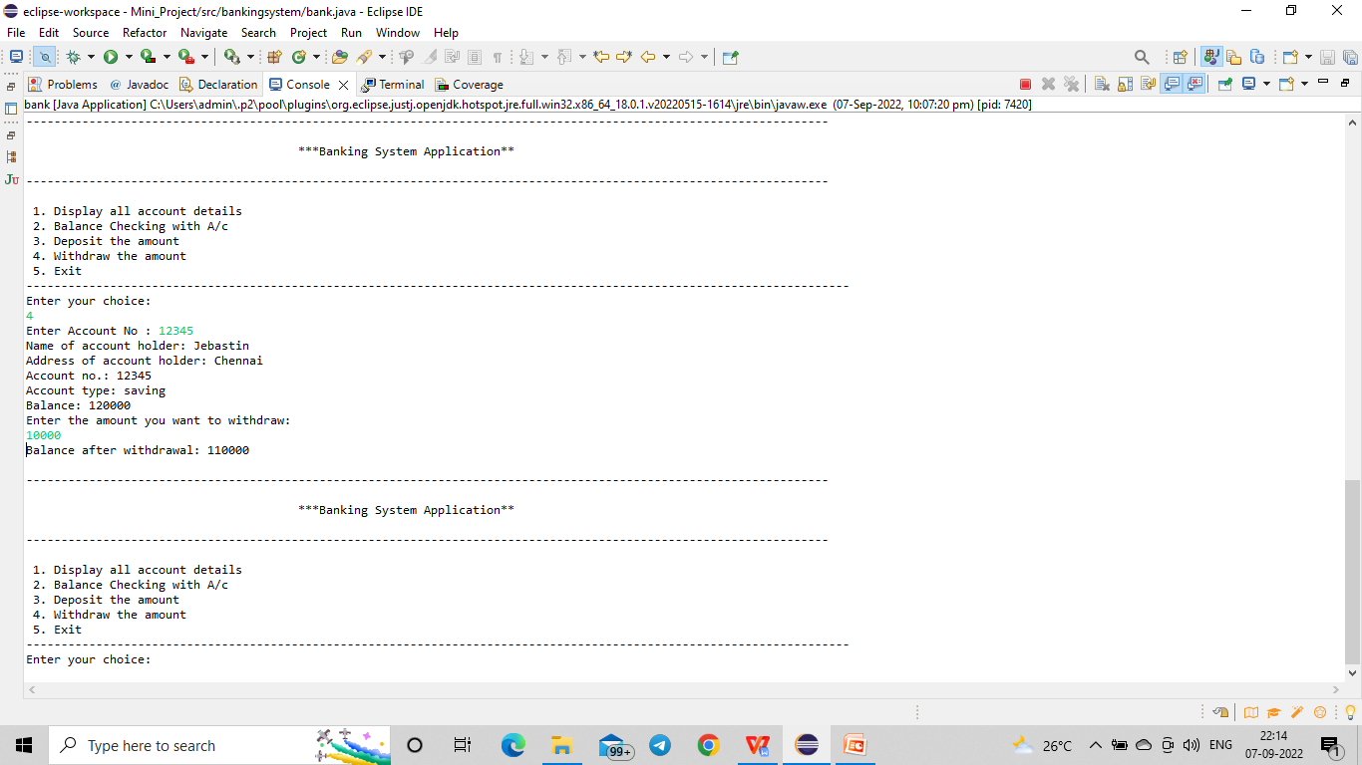
Withdraw details

Slide 14
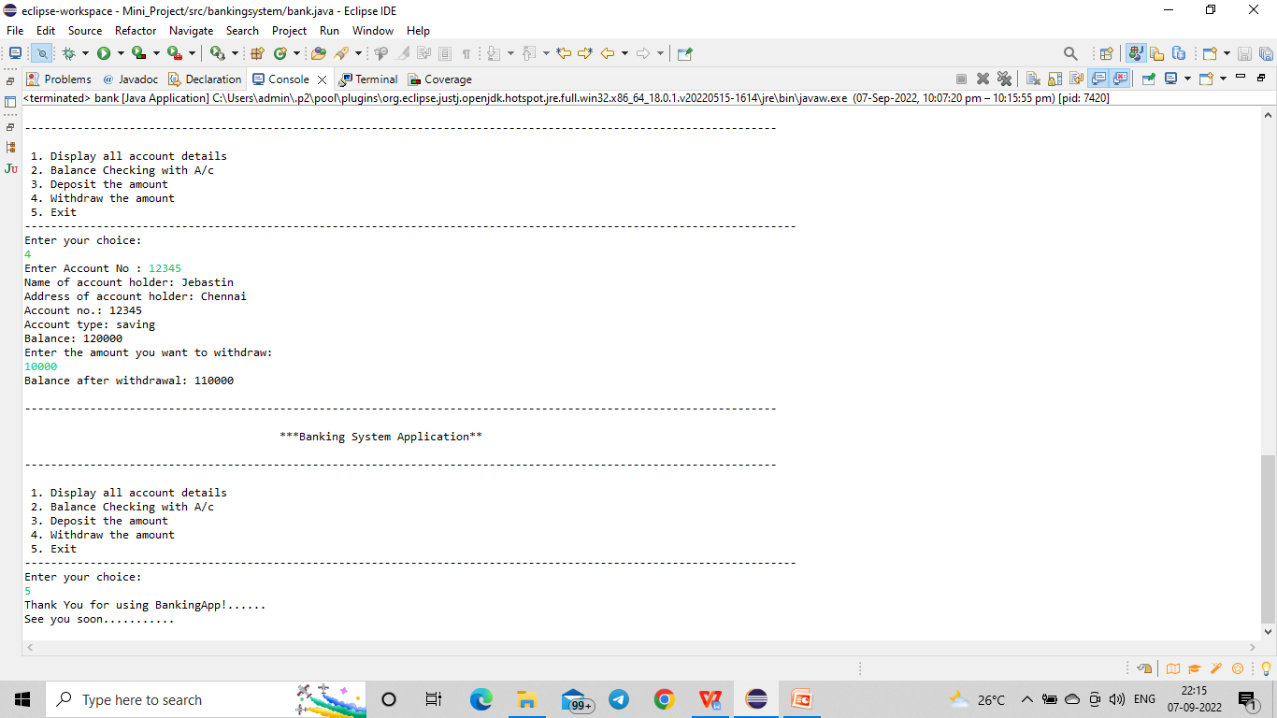
Exit

Slide 15
Thank you……….!!!!!!!!!!!

